Slide 1

The outer limits
A new way of transport

Slide 2
Outline
Motivations: The problem of the conventional transportation ways
Conventional means of transport
Pros and cons
Designing a better solution
The friction issue: solid and fluid contact
Quantifying the energy consumption: the combustion engine model
The hyperloop project
Conclusion

Slide 3
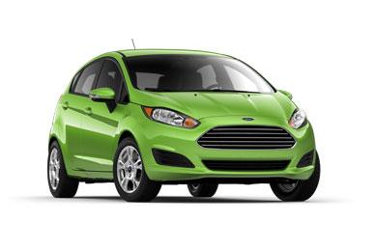
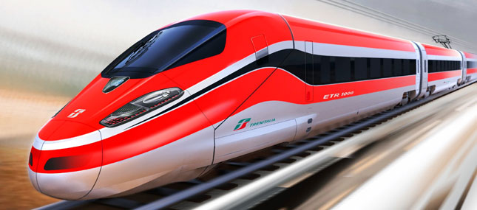

Motivation

Slide 4
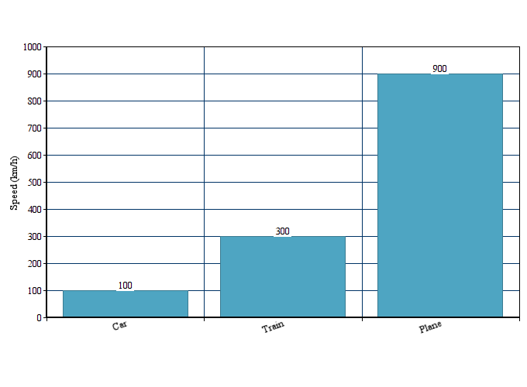
Speed that we can think of

Slide 5
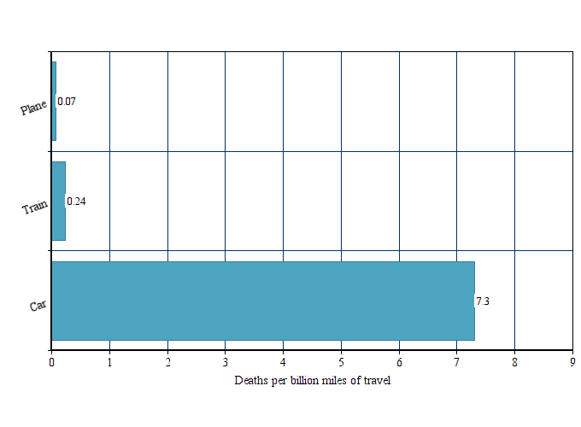
Safety issue
Data: Ian Savage, http://faculty.wcas.northwestern.edu/~ipsavage/436.pdf

Slide 6
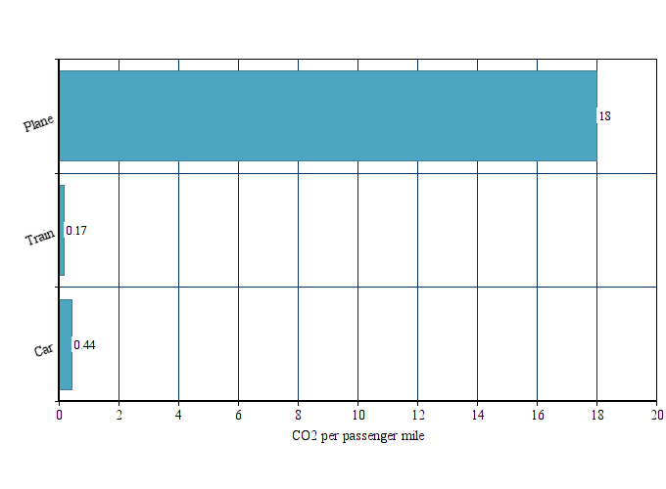
Pollution rate
Data: wikipedia.org

Slide 7
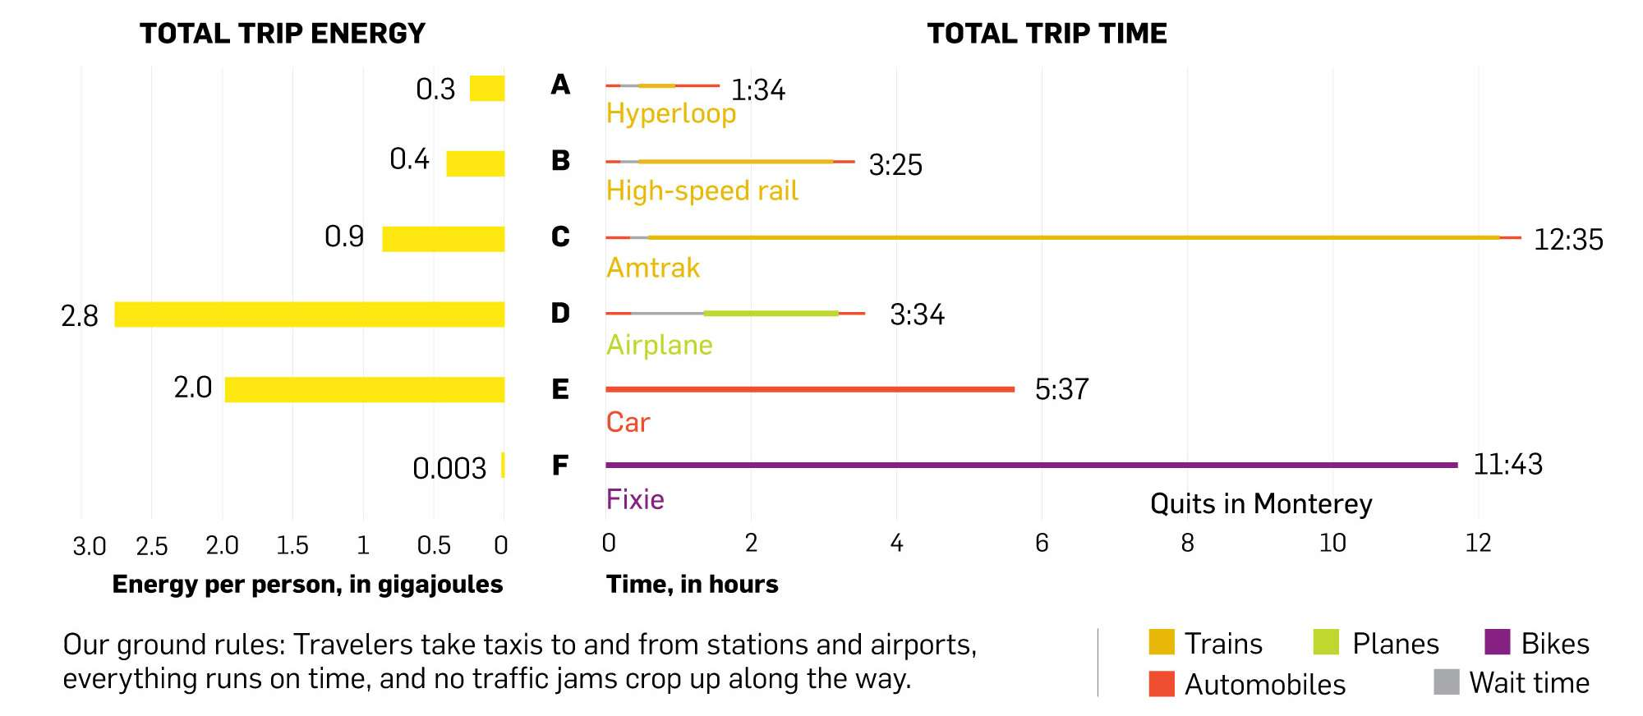
SF to LA
Data: Department of Transportation; Oak Ridge Transportation Energy Data Book; Google Maps; Mikhail Chester, Arizona State University; Elon Musk, Hyperloop White Paper; Megan Ryerson, University of Pennsylvania; California High Speed Rail Authority

Slide 8
In a nutshell
Transport | Advantages | Disadvantages
Car | Cheap You choose time for departure | Not safe Slow
Plane | Fast Cheap | Long time to check-in and board Airports are far away Flights are rare Big CO2 remission
Train | Easy and fast to board Train stations are in a downtown normally Comfortable Low CO2 emission | Slow when distance is big Expensive

Slide 9
II. Designing a better solution
Designing a better solution
The friction issue: solid and fluid contact
Quantifying the energy consumption: the combustion engine model
Rethink the movement: the static movement model
What are the main physical issues faced by a body in motion?
How to quantify this dynamical constraint?
How to build a motion engine by limiting the effect of this dynamical constraint?

Slide 10

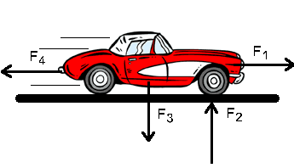
The friction issue: solid and fluid contact
Formal definition (over one point):
Opposition force created by the motion
is the motion force
Designing a better solution
The friction issue: solid and fluid contact
Definition of the friction energy
How to fight friction.
Get rid of friction
Quantifying the energy consumption: the combustion engine model
Rethink the movement: the static movement model

Slide 11
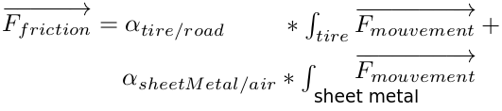
The friction issue: solid and fluid contact
Formal definition (over all the solid):
Designing a better solution
The friction issue: solid and fluid contact
Definition of the friction energy
How to fight friction.
Get rid of friction
Quantifying the energy consumption: the combustion engine model
Rethink the movement: the static movement model

Slide 12
The friction issue: solid and fluid contact
Formal definition (over all the solid):
Designing a better solution
The friction issue: solid and fluid contact
Definition of the friction energy
How to fight friction.
Get rid of friction
Quantifying the energy consumption: the combustion engine model
Rethink the movement: the static movement model

Slide 13
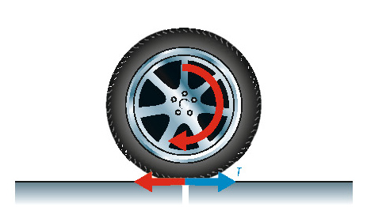
The friction issue: solid and fluid contact
Outline
The friction issue: solid and fluid contact
Definition of the friction energy
How to fight friction.
Get rid of friction
Quantifying the energy consumption: the combustion engine model
Rethink the movement: the static movement model

Slide 14
The friction issue: solid and fluid contact
More formally:
Newton’s 1st principle: “The rate change of linear momentum of an object is directly proportional to the external force on the object”.
Newton’s 2nd “Every action has an equal and opposite reaction”.
Friction Movement.
Outline
The friction issue: solid and fluid contact
Definition of the friction energy
How to fight friction.
Get rid of friction
Quantifying the energy consumption: the combustion engine model
Rethink the movement: the static movement model

Slide 15
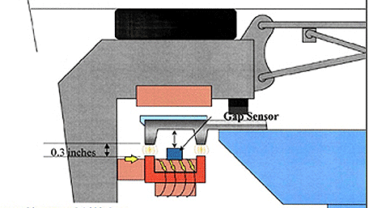
The friction issue: solid and fluid contact
Conclusion:
Do not remove the friction
Remove the biggest part of the friction: solid friction
Outline
The friction issue: solid and fluid contact
Definition of the friction energy
How to fight friction.
Get rid of friction
Quantifying the energy consumption: the combustion engine model
Rethink the movement: the static movement model

Slide 16
Quantifying the energy consumption
Kinetic energy:
Only depends on the weight and the speed
Represents the energy needed to create the motion and to fight friction
Outline
The friction issue: solid and fluid contact
Quantifying the energy consumption: the combustion engine model
Formal quantification of the movement energy
Rethink the movement: the static motion model

Slide 17
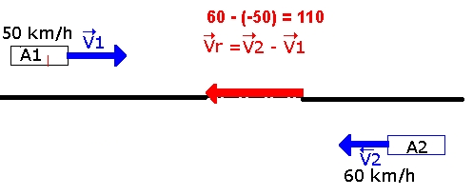
Reconsider the movement
Formal definition a movement:
Function of the referential
Einstein: “Everything is relative”
Outline
The friction issue: solid and fluid contact
Quantifying the energy consumption: the combustion engine model
Formal quantification of the movement energy
The reciprocating engine
Reconsider the movement: the static motion model
What is a movement
Motion without impulse

Slide 18
Reconsider the movement: the static motion model
Creating a movement on a solid:
External impulse on the solid
Referential motion: idea of the referential
Outline
The friction issue: solid and fluid contact
Quantifying the energy consumption: the combustion engine model
Formal quantification of the movement energy
The reciprocating engine
Rethink the movement: the static motion model
What is a movement
Motion without impulse

Slide 19
Reconsider the movement: the static motion model
Creating a movement on a solid:
The movement by depression:
1st principle of thermodynamic: “A system where different parts have different level of energies will tend toward stabilisation”
Outline
The friction issue: solid and fluid contact
Quantifying the energy consumption: the combustion engine model
Formal quantification of the movement energy
The reciprocating engine
Rethink the movement: the static motion model
What is a movement
Motion without impulse

Slide 20
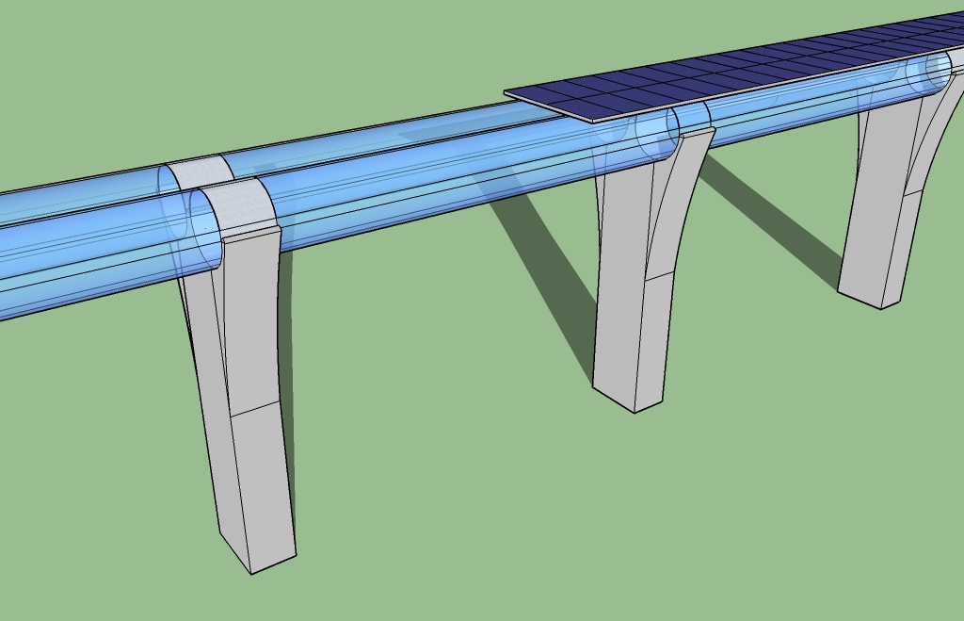
III. The hyperloop project

Slide 21
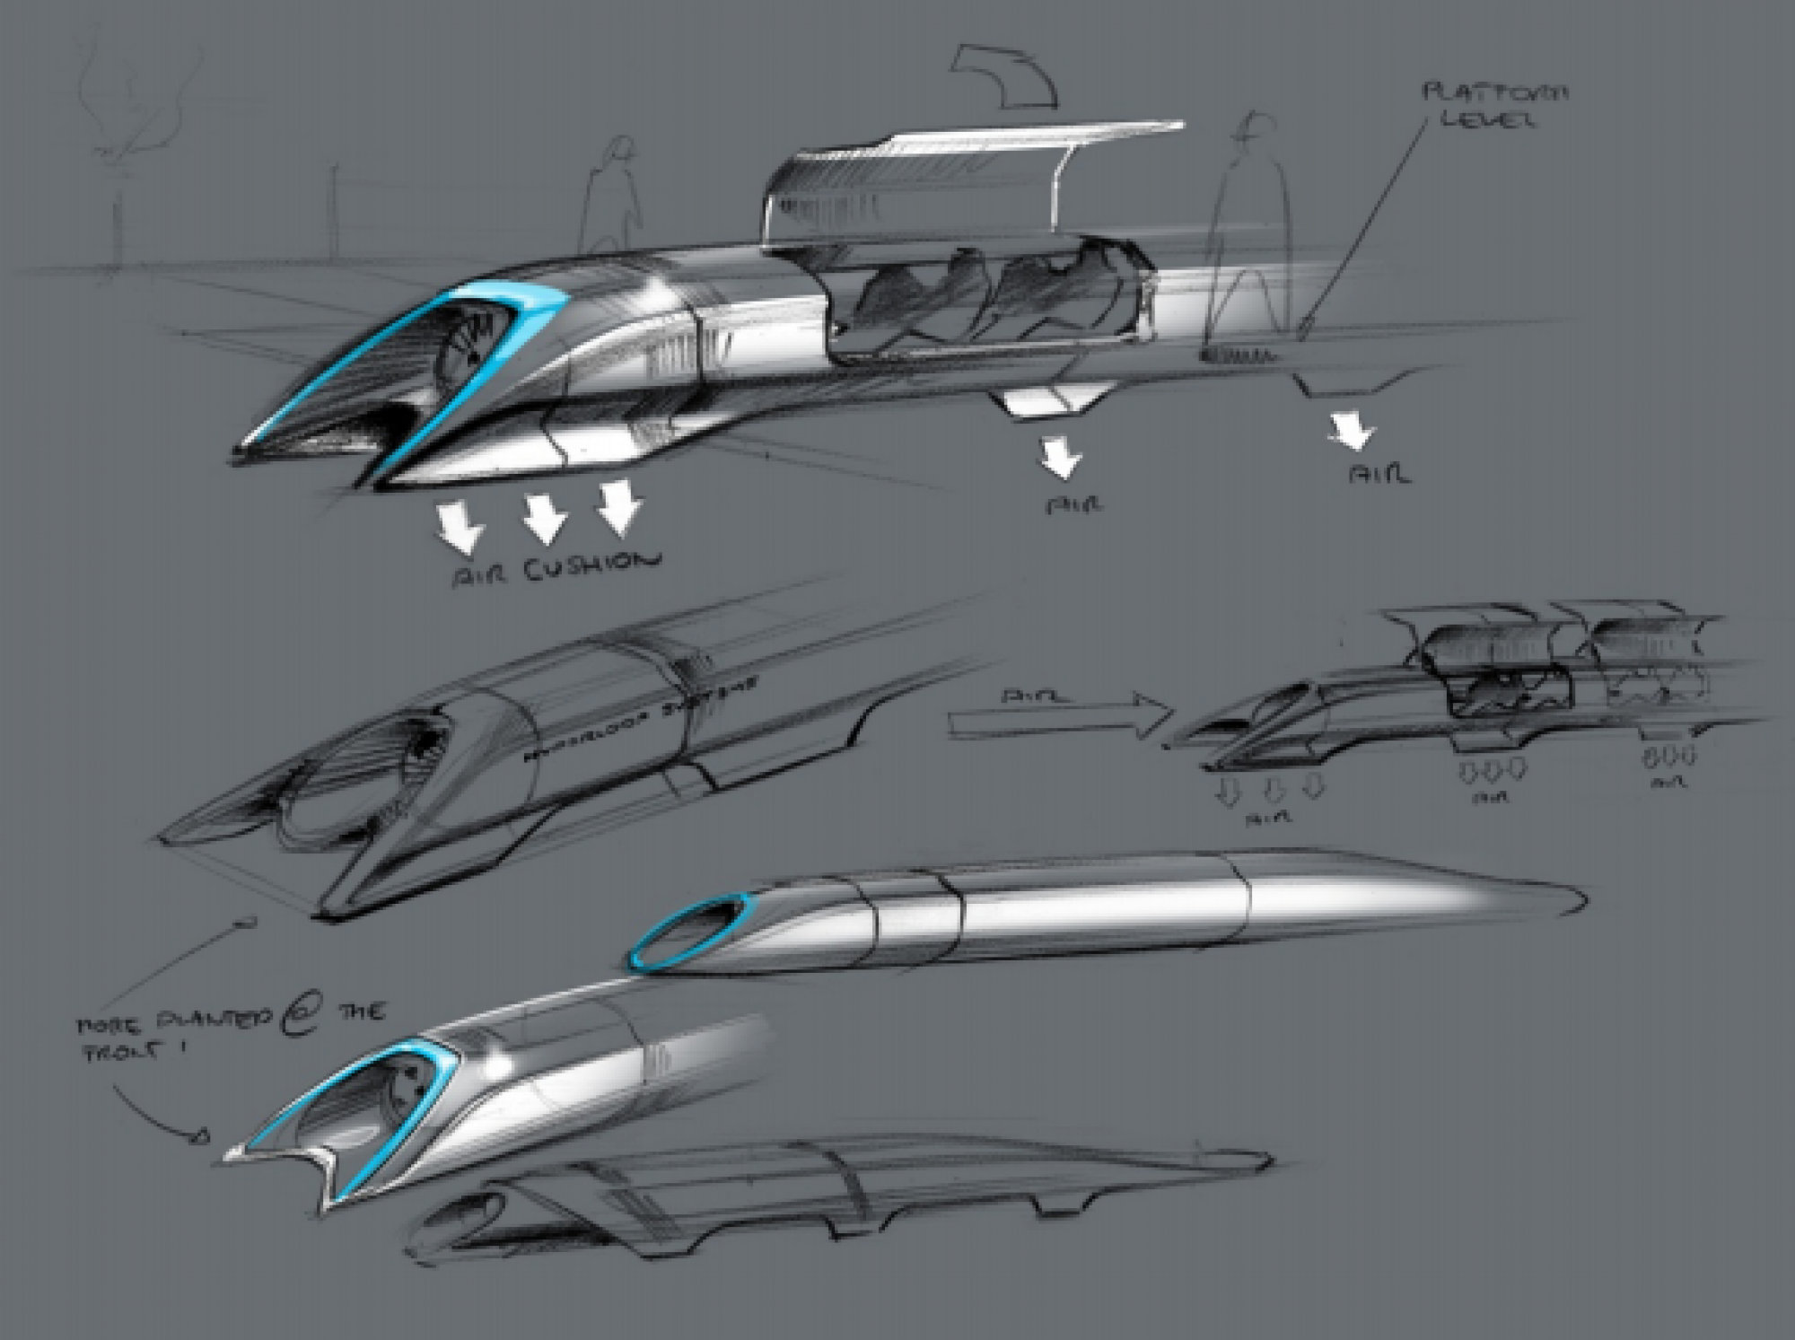
Main features
Speed from 480 up to 1220 km/h depending on landscape
Capsules every 30 seconds
Air cushion
Solar energy usage
Energy production from braking of capsulas

Slide 22
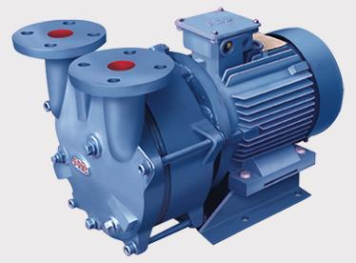
Vacuum idea
No need to maintain ideal vacuum (0 Pa)
Fore-vacuum of 100 Pa (1/1000 of air pressure) is enough
Lower price of pumps and construction

Slide 23
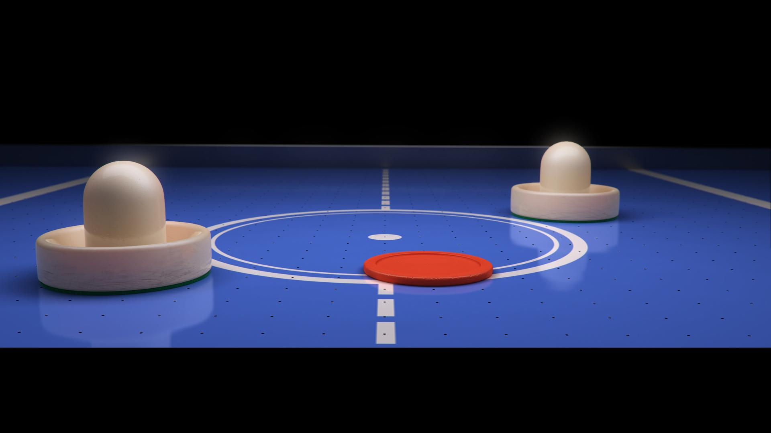
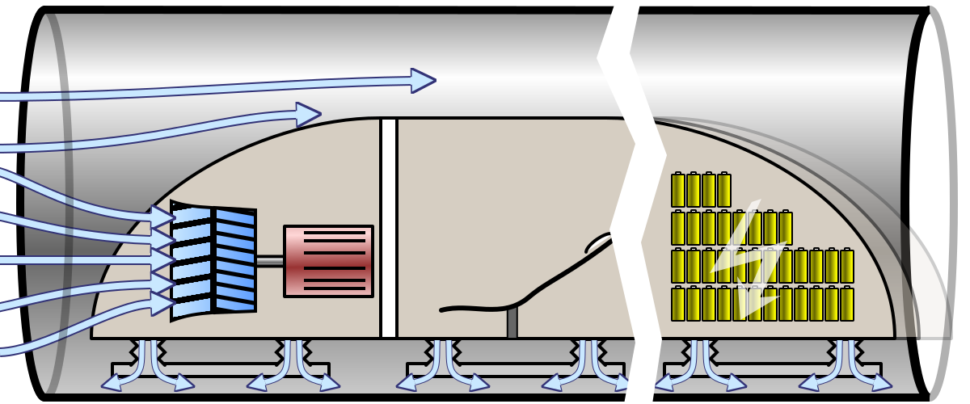
Air cushion
Capsulas float on a 0.5-1.3 mm layer of air
Active transfer of high air pressure air from front to the rear of the vessel

Slide 24
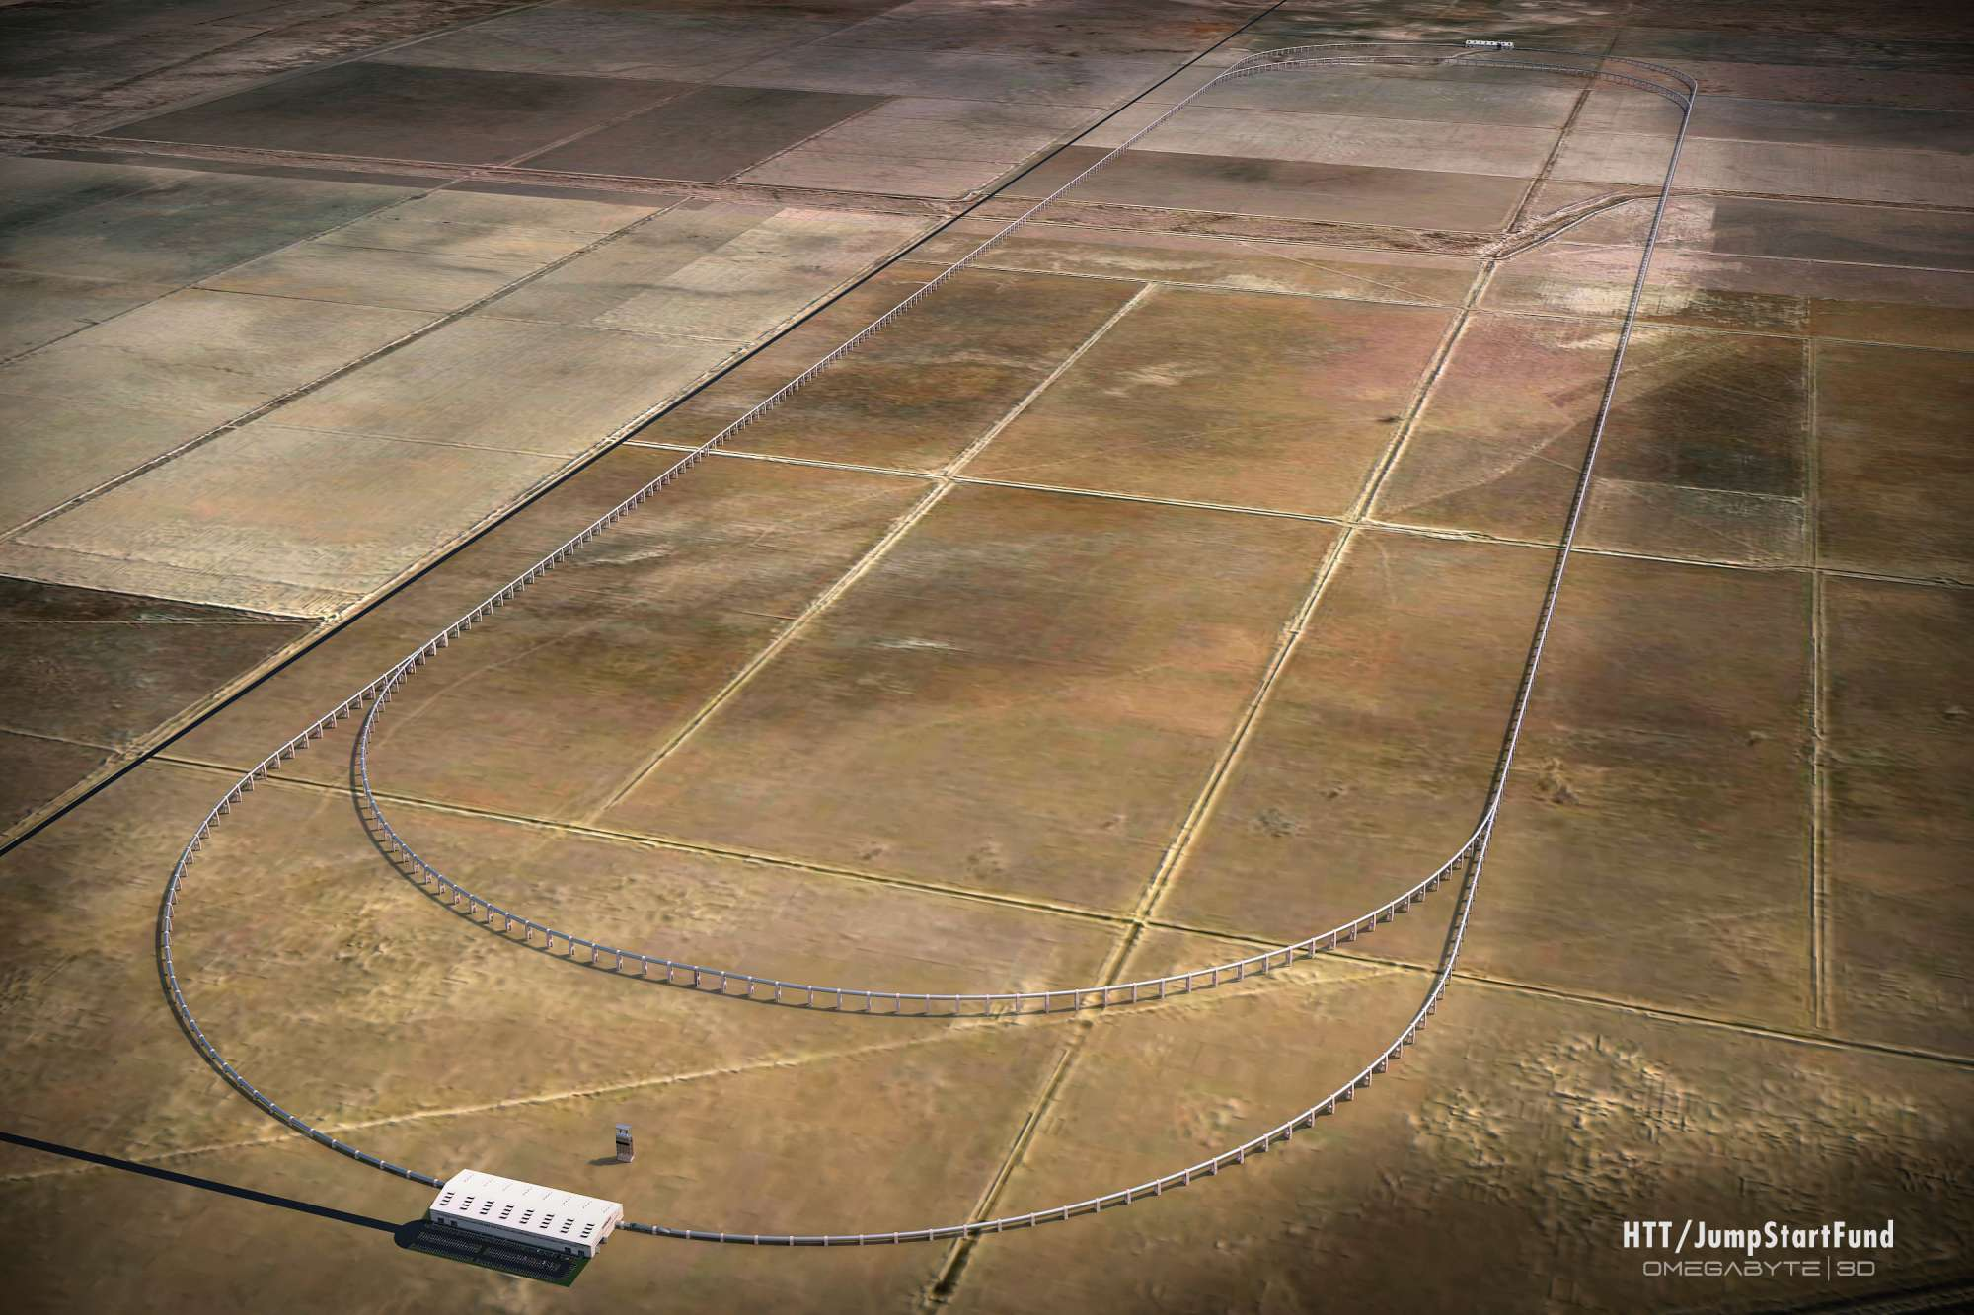
Modeling problems
Heating of the the capsule surface (Ansys)
Rotation around the longitudinal axis (Ansys)
Speed of 1220 is unreachable (The MathWorks)
Diameter of the tube is too small (NASA Glenn Research Center)

Slide 25
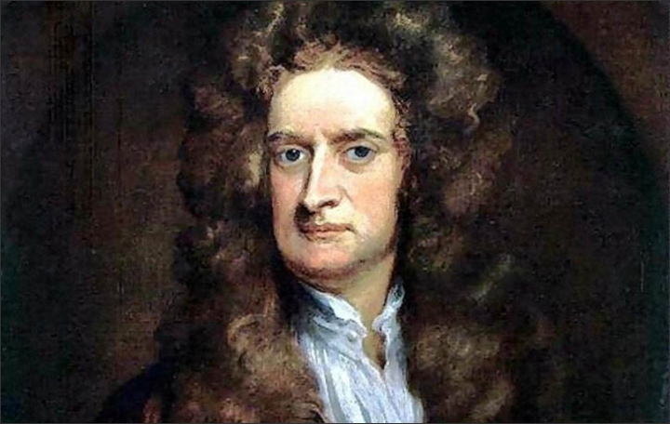
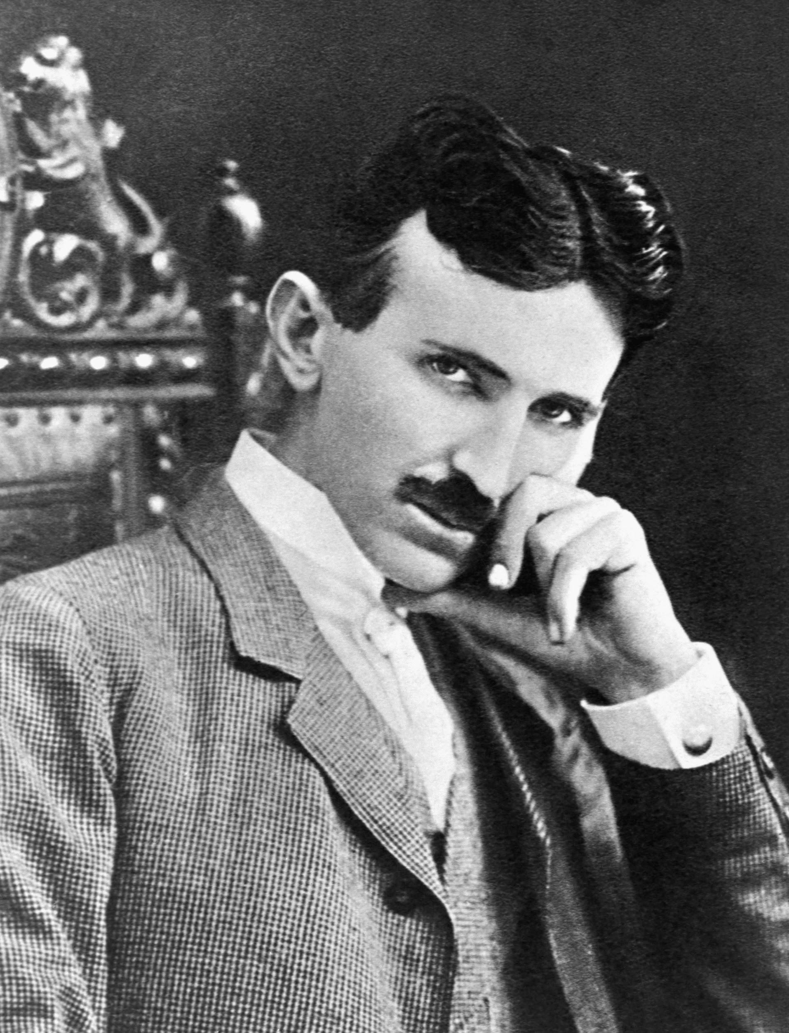
Conclusion
Very simple physical principles described by Isaac NEWTON in the 17th century
Improvement and implementation realised by Nikolas TESLA in the early 19th century (the floating infinite engine)
However, the industry still does not use it in the 21st century.
Why?

Slide 26
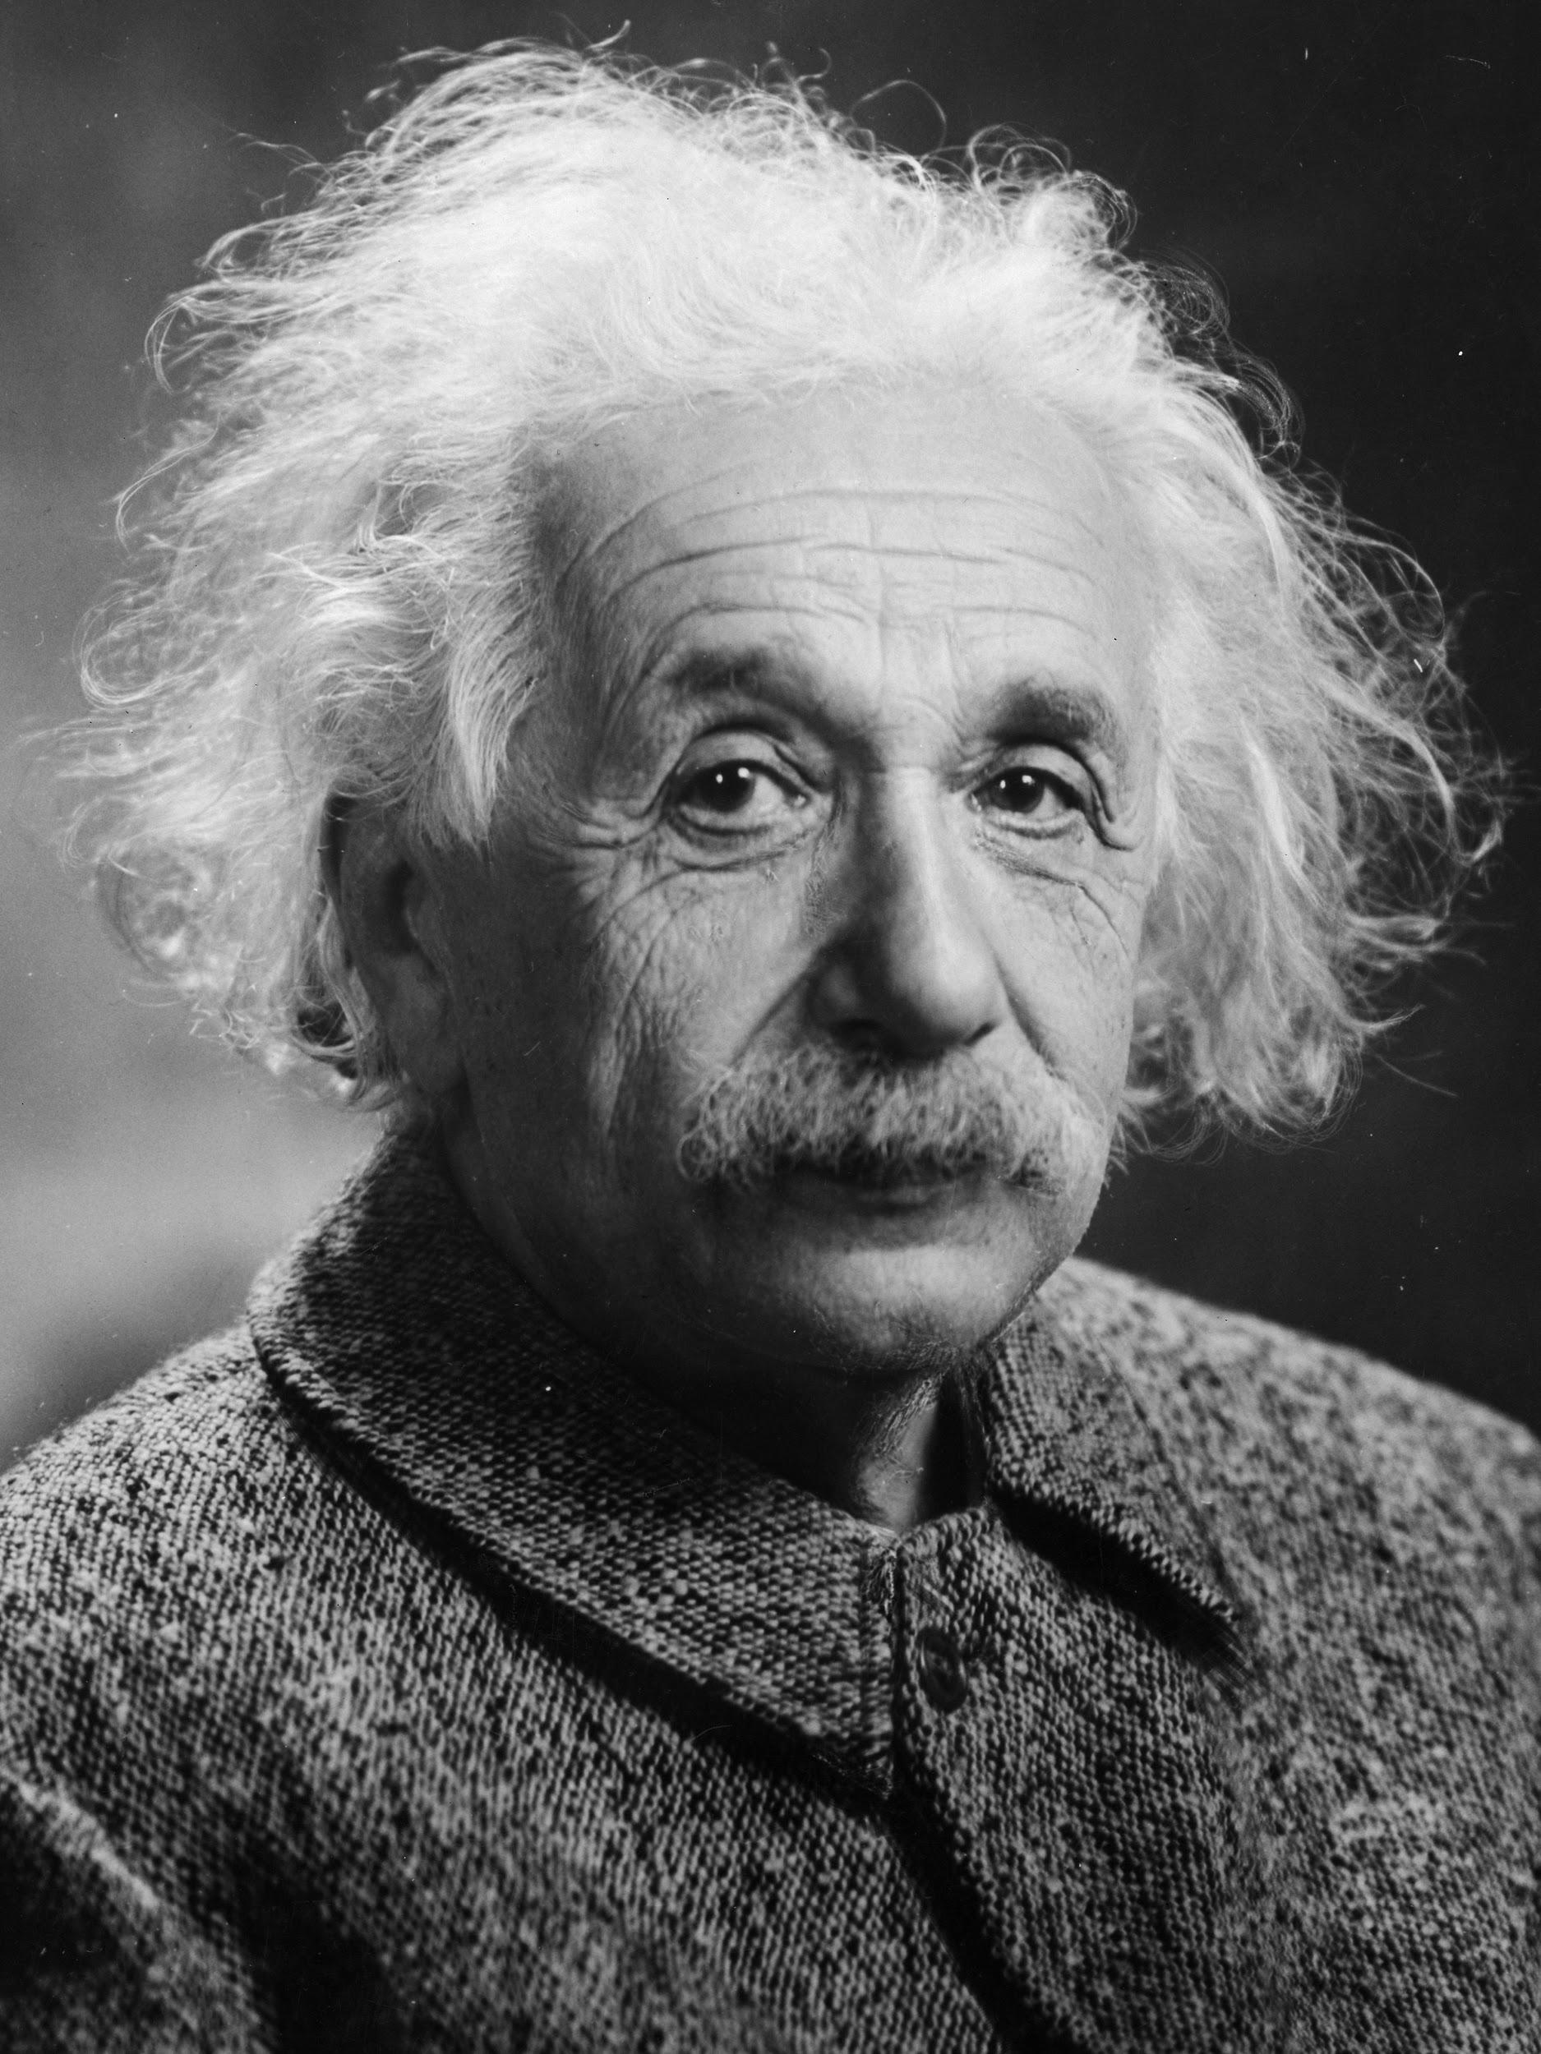
Conclusion
Albert EINSTEIN:
“The industry will never renew a process before having drawn all its profits”

